Slide 1


Advisor : Hoon Sung Chwa
Weekly Meeting
25.08.01.
Dept of Electronic Engineering & Computer Science, DGIST
Real-Time Computing Lab
Moonyoung Choi (cmy021205@dgist.ac.kr)
Notes:
Weekly meeting 표지

Slide 2
Goal
Goal: Analyzing Latency in Autonomous Drone Navigation via Offboarding
Requirement:
Understanding the Logic of Autonomous Drone Navigation via Offboarding
Analyzing Latency at Each Stage of the Process
MAVROS Communication Flow
Testing ROS Topics Required for Latency Measurement and Autonomous Navigation
2

Slide 3




Background
PX4 commander by On-boarding vs Off-boarding
On-boarding
Off-boarding
command 생성
Drone Software
Simulator
command 생성
MAVROS
Middleware
Drone Software
Simulator
3

Slide 4
Background
Topic vs Service
 | Topic | Service
Communication | Publisher-Subscriber | Request-Response
Activation | 지속적인 데이터 | 일회성 명령
Purpose | Data Flow | Command (by user)
example | sensor, position, status | task
4

Slide 5
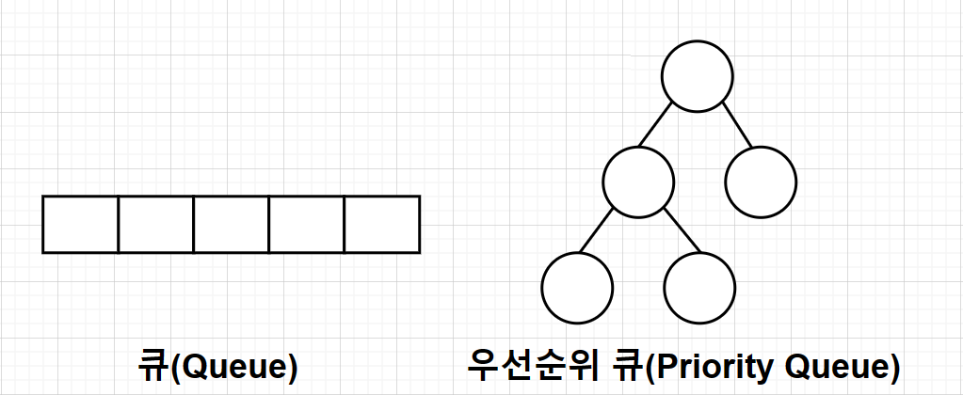
To do
Latency of Service Commands under topic traffic in MAVROS
service call: arming
topic pub: set_position
keep-alive message
(offboard mode 유지)
MAVROS
PX4
ROS2
set_position
set_position
set_position
set_position
set_position
arming
arming
5

Slide 6
명령 처리 과정(Old)
명령 처리 과정
keep-alive message
(offboard mode 유지)
ROS2
Service
Service
Topic
param
MAVROS
Plugin
Plugin
Plugin
Plugin
send_message()
send_message()
send_message()
send_message()
router
개별적으로 처리
send_to_lib()
send_to_lib()
send_to_lib()
libmavconn
최종 Queue에서 명령이 모인다
Queue → PX4
6

Slide 7
명령 처리 과정(New)
ROS2
Service
Service
Topic
param
MAVROS
Plugin
Plugin
Plugin
Plugin
send_message()
send_message()
send_message()
send_message()
router
send_to_pQ()
send_to_pQ()
send_to_pQ()
우선순위 부여
Priority Queue
우선순위 처리
libmavconn
Queue → PX4
7
Notes:
1: 간접솔루션 피포큐 밑에 프리어러티 큐를 만들었따. 이때
한계 + 왜 이런방법을 했는지
2: pQ 공부하기(웅기)
3: 명백한 솔류션(립마브콘 큐를 프리어러티 큐로 수정)
왜 어려운지
락걸리고 플로우랑 구조
잘 설명해보자
새로 알게된 정보로 계획

Slide 8
명령 처리 과정(New)
ROS2
Service
Service
Topic
param
MAVROS
Plugin
Plugin
Plugin
Plugin
send_message()
send_message()
send_message()
send_message()
router
send_to_pQ()
send_to_pQ()
send_to_pQ()
Priority Queue
send_to_lib()
libmavconn
Queue → PX4
8

Slide 9
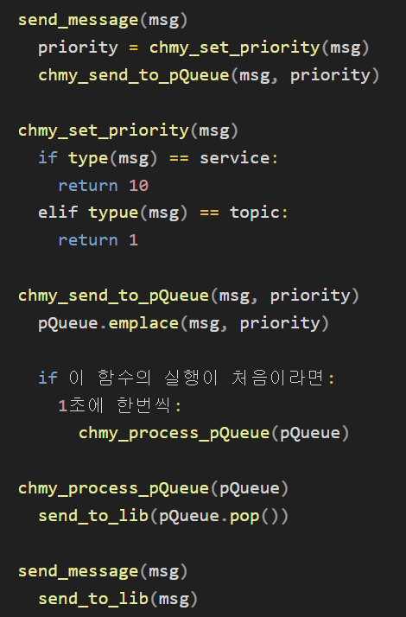
Priority Queue
Priority Queue code
Old
추가된 함수
New
9

Slide 10
Priority Queue
Priority Queue 처리 방식
Service
Service
Topic
Topic
Topic
Topic
주기적으로 일괄 처리
Service
Service
Topic
Topic
Topic
Topic
10

Slide 11
Priority Queue
Priority Queue & libmavconn Queue
PQ
High
High
High
Low
Low
Low
lQ
11

Slide 12
Priority Queue
Priority Queue & libmavconn Queue
PQ
lQ
High
High
High
Low
Low
Low
12

Slide 13
Priority Queue
Priority Queue & libmavconn Queue
PQ
High
Low
Low
Low
lQ
High
High
High
Low
Low
Low
13

Slide 14
Priority Queue
Priority Queue & libmavconn Queue
PQ
High
Low
Low
Low
lQ
Low
Low
14

Slide 15
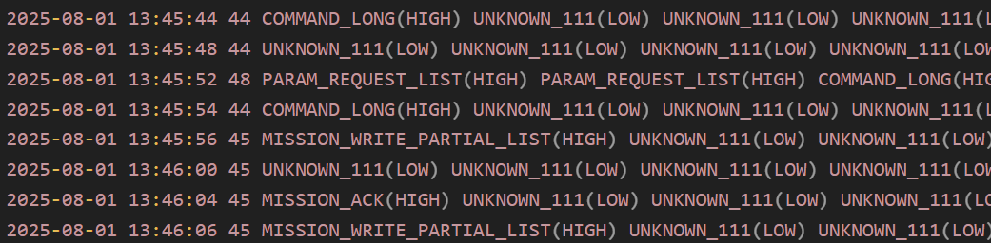
Priority Queue
Priority Queue & libmavconn Queue
PQ
lQ
Low
Low
High
Low
Low
Low
15
Notes:
multi level

Slide 16
To do
Priority Queue & FIFO Queue 출력하기
Priority Queue 처리 방식
이게 맞나?
command delay 비교: Priority Queue vs FIFO Queue
16

Slide 17

Advisor : Hoon Sung Chwa
Thank you
Dept of Electronic Engineering & Computer Science, DGIST
Real-Time Computing Lab
Moonyoung Choi (cmy021205@dgist.ac.kr)

